Slide 1
nopCommerce Automation Testing Project
Automation Framework using Selenium, TestNG, and Java
PPT Prepared By: Ankush

Slide 2
Agenda
Project Overview
Tools & Technologies
Test Scenarios
Framework Structure
Test Case Execution Flow
Reports & Results
Screenshots of automation

Slide 3
Project Overview
Application: nopCommerce (https://demo.nopcommerce.com)
Testing Approach: Automated Functional Testing
Test Framework: Selenium WebDriver + TestNG/Cucumber
Data Handling: Excel Integration
Reports: TestNG Listeners (Extent Reports)

Slide 4
Tools & Technologies
Java (Programming Language)
Selenium WebDriver (Automation Tool)
Cucumber (BDD framework)
TestNG (Test Framework)
Apache POI (Excel Integration)
Maven (Build Tool)
Extent Reports (Reporting)

Slide 5
Test Scenarios Covered
Register Test Case (with new and existing data)
Login Test Case (Valid & Invalid)
SubModules/Categories Verification
Hover on Computers Category
Click on Desktop
Select a product (product details fetched from excel)
Add to Cart
Shopping Cart Verification
Checkout Process Verification

Slide 6
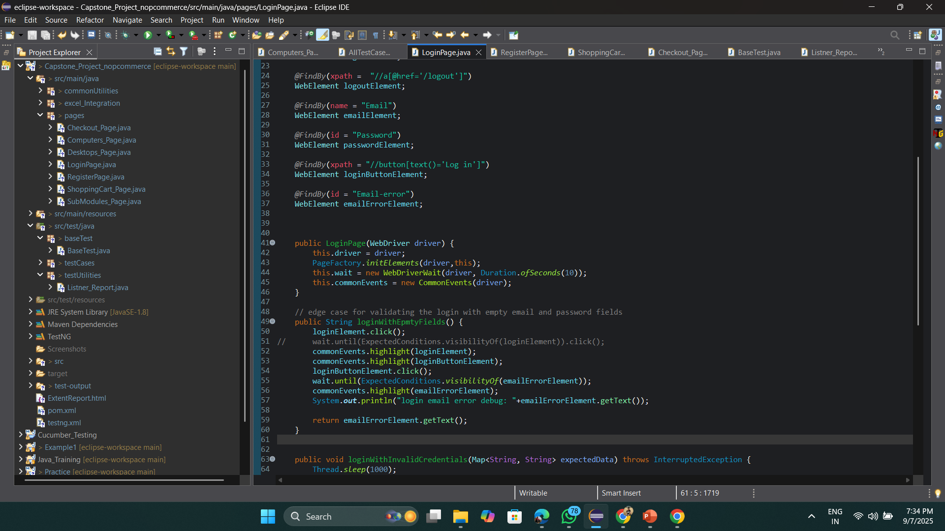
Framework Structure
baseTest – Contains BaseTest class for WebDriver setup
pages – Page Object classes for Register, Login, Cart, etc.
excel_Integration – Handles test data from Excel
testCases – Contains test classes (AllTestCase.java)
testUtilities – Custom listeners & reporting utilities
resources – Test data files (Excel)

Slide 7
Test Case Execution Flow
BaseTest initializes WebDriver
Test data fetched from Excel
Page Object classes handle UI interaction
Assertions validate expected vs actual results
Reports generated using Listeners, Extent Report
Screenshots captured for failures

Slide 8
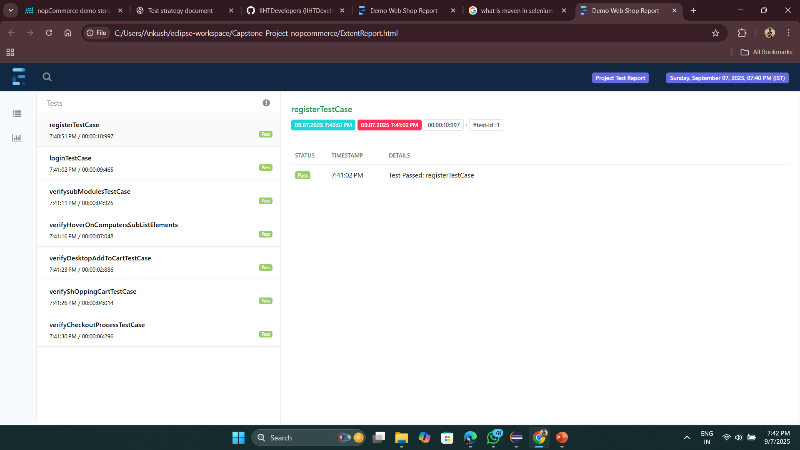
Reports & Results
Automated reports generated using TestNG Listeners
Extent Reports used for detailed HTML reports
Includes pass/fail status, execution time, and logs
Supports screenshot embedding for failures

Slide 9
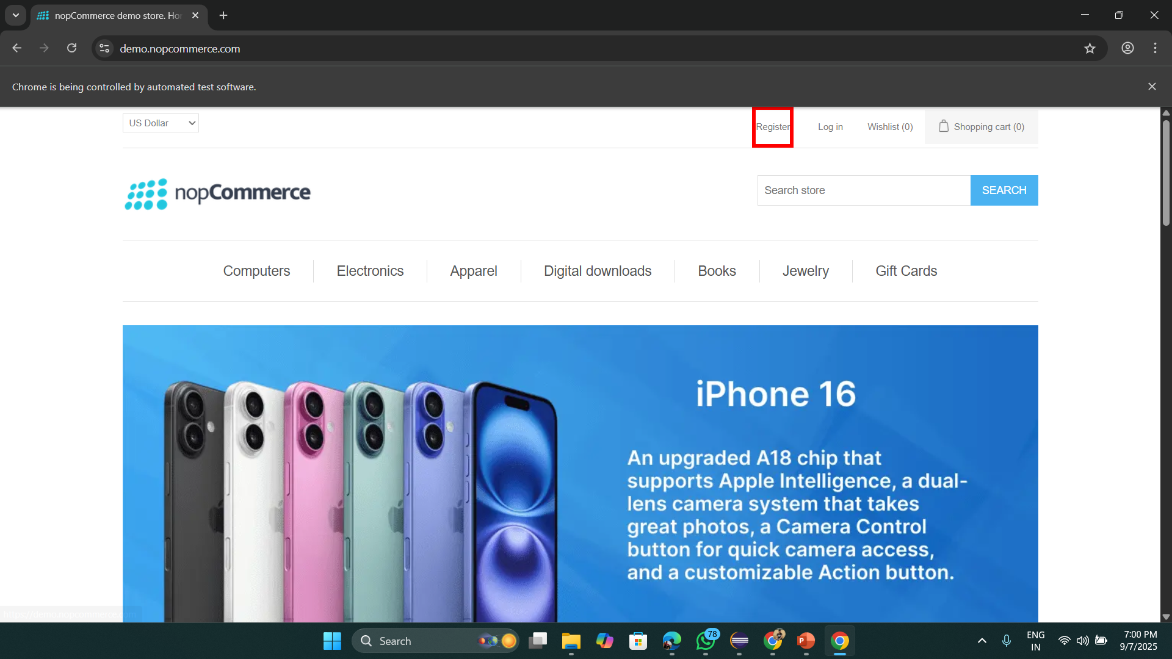
Clicked on register

Slide 10
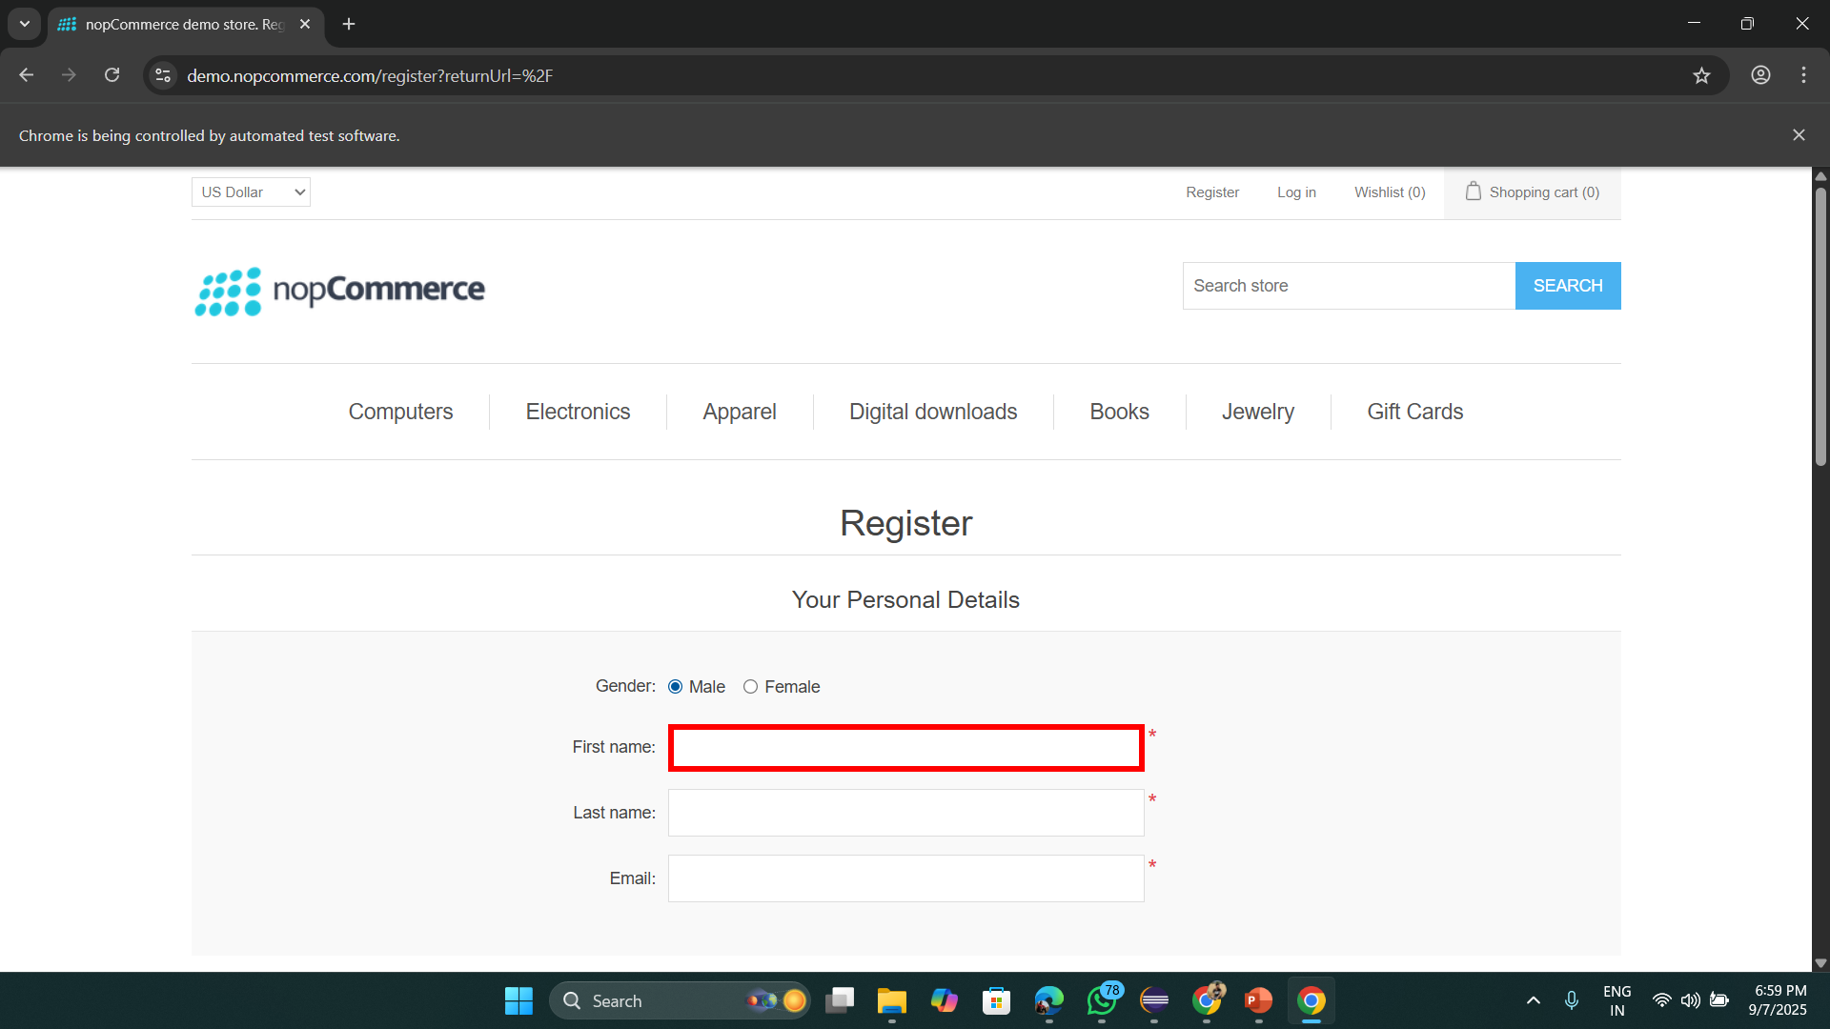
Validating and Fetching Data from excel file and filling empty fields here

Slide 11
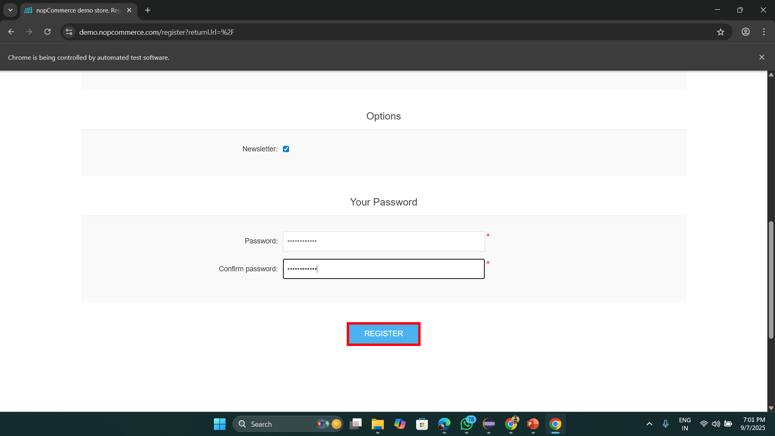
Clicking on Submit Register button

Slide 12
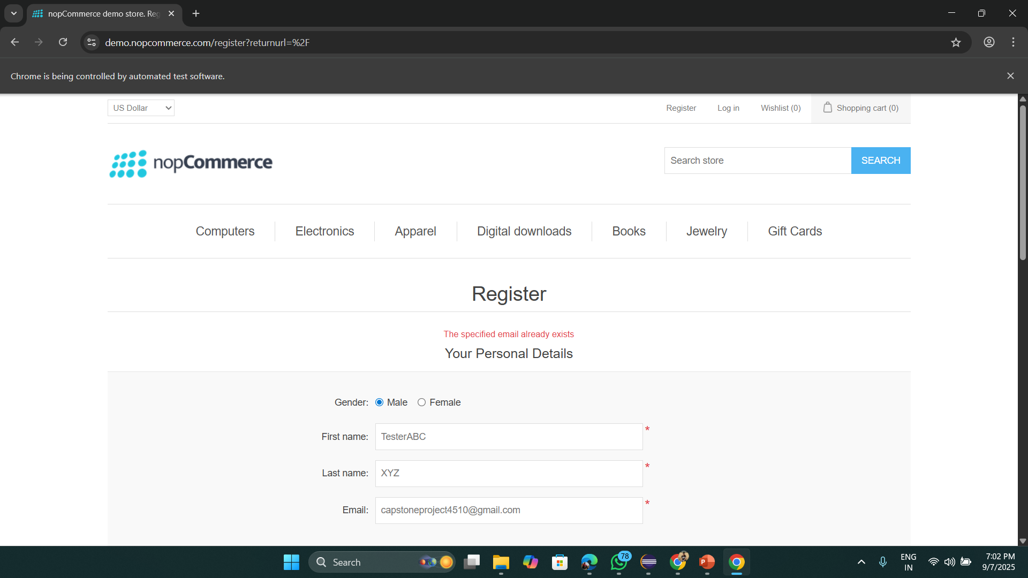
Validating Edge Case If email already registered

Slide 13
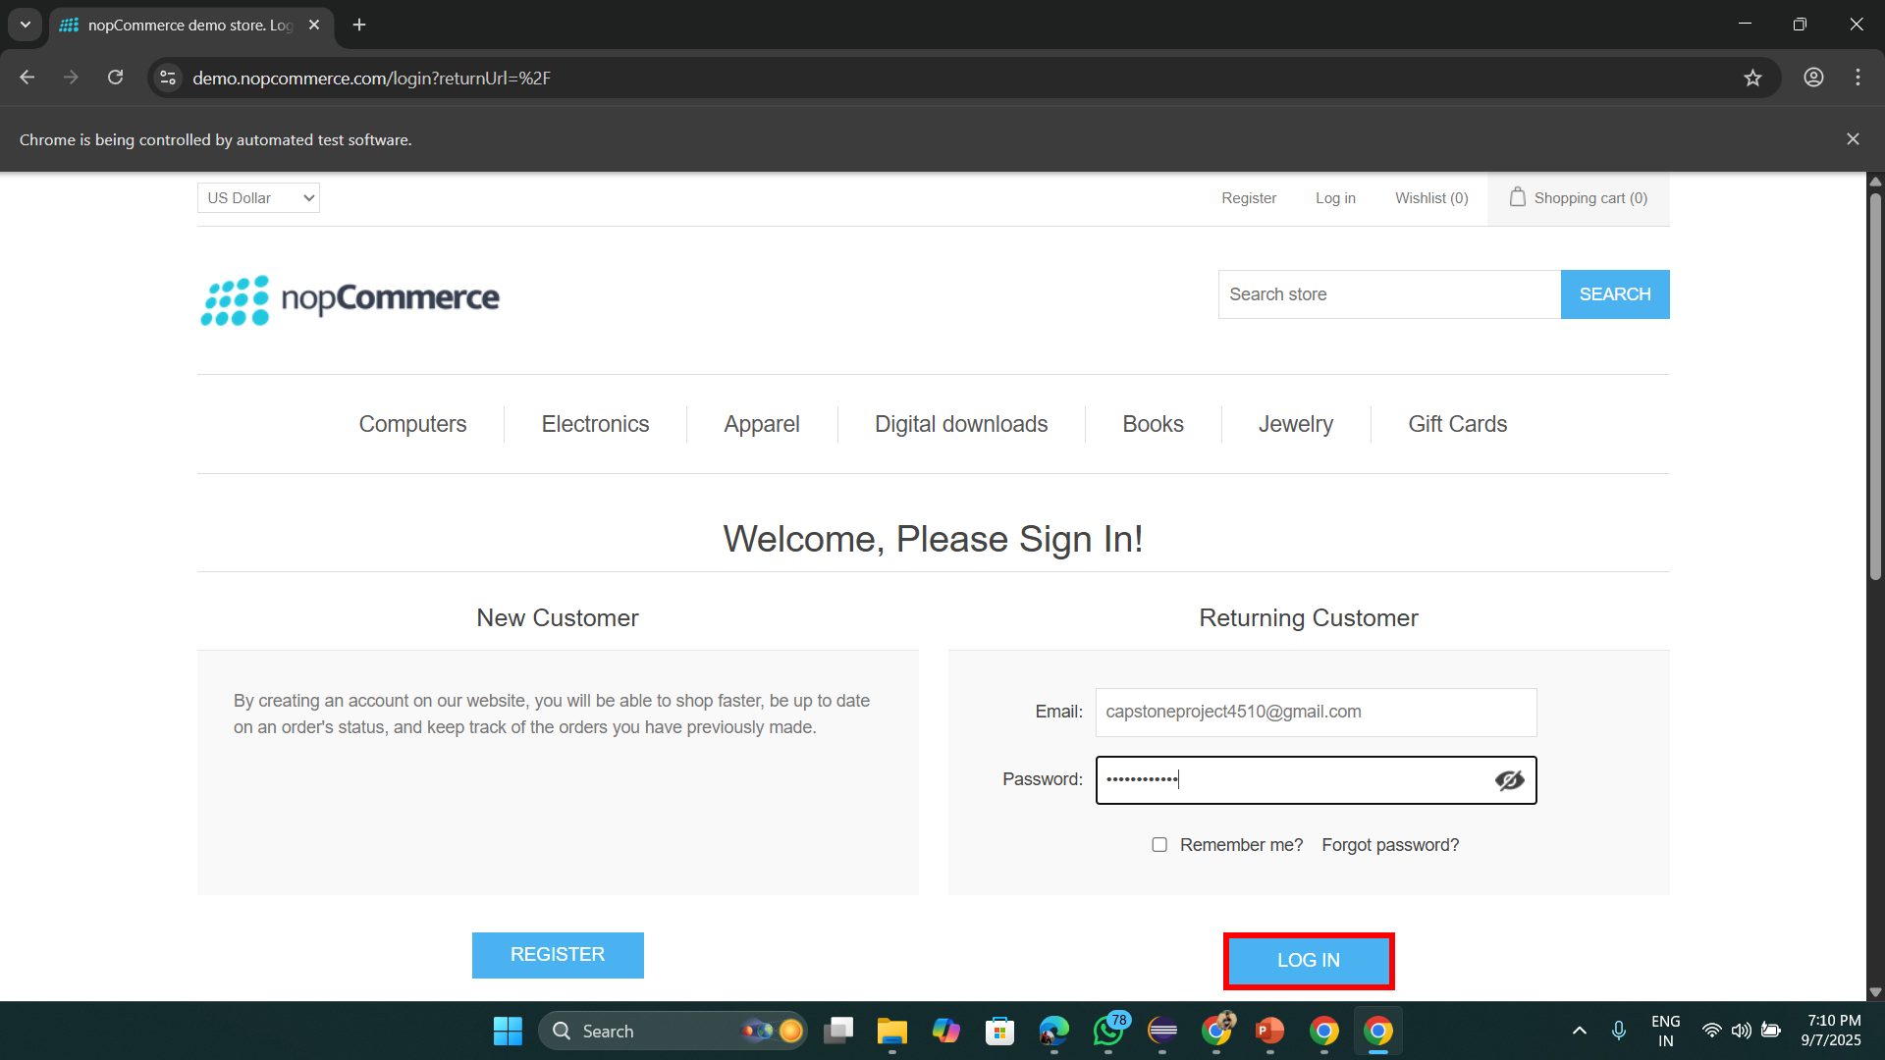
Validating login

Slide 14
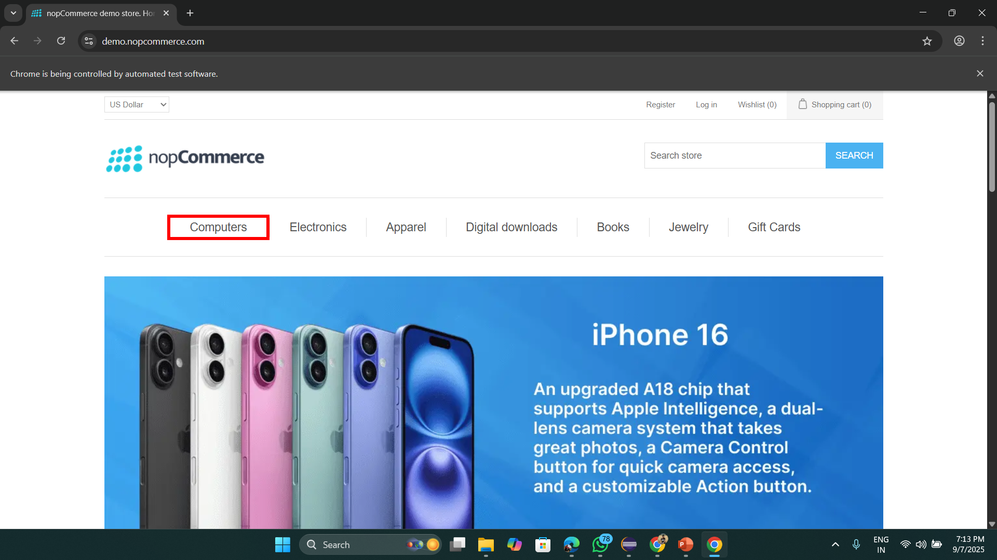
Validating Different Categories

Slide 15
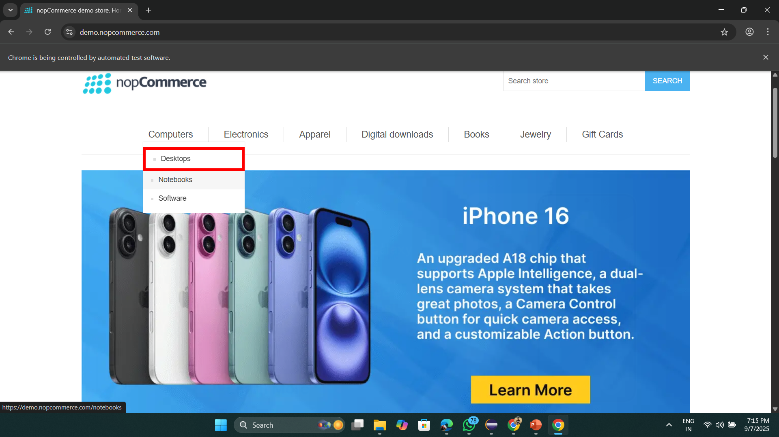
Validating Hover on Categories

Slide 16
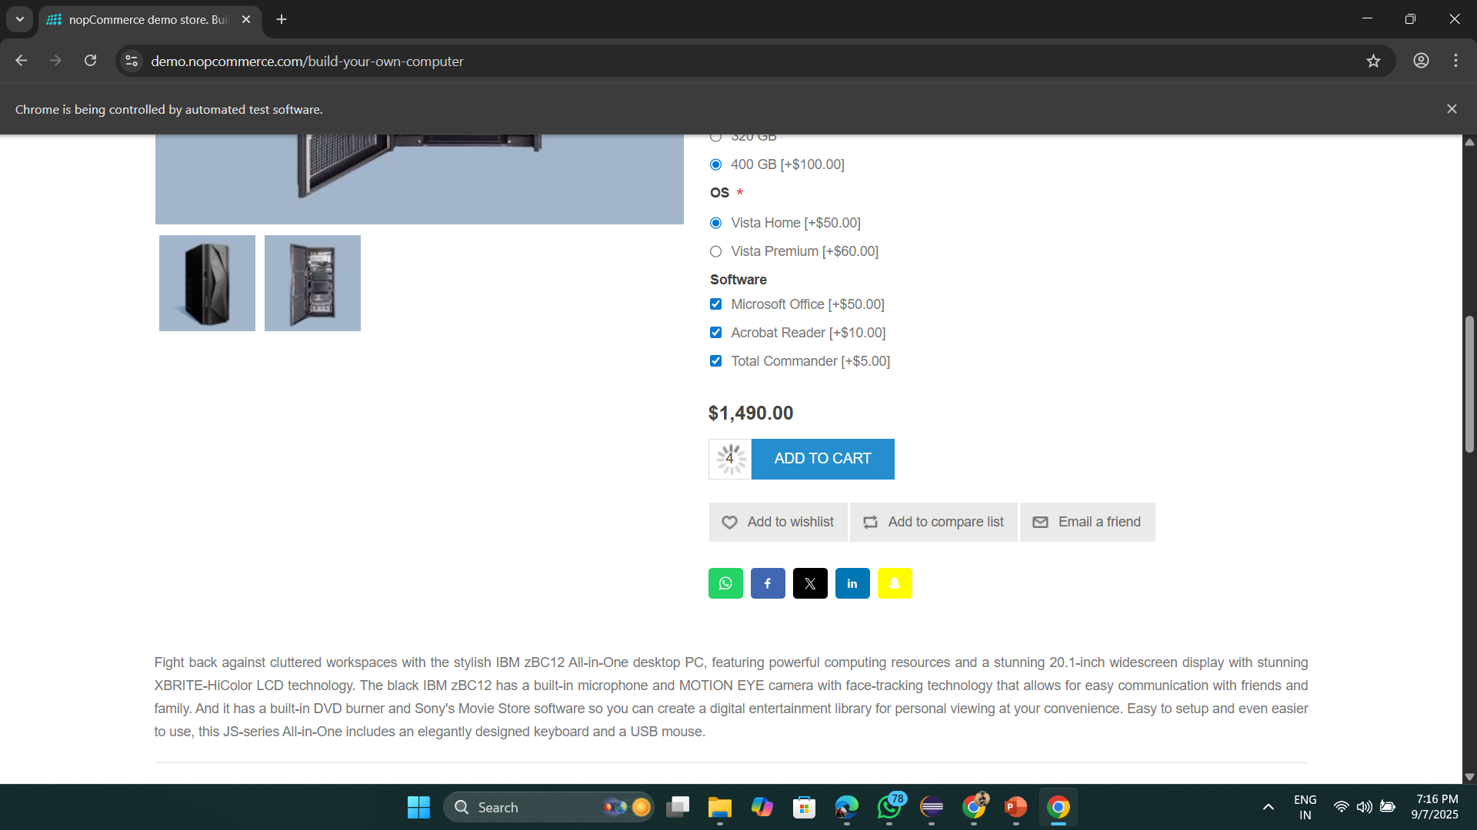
Validating add to cart button

Slide 17
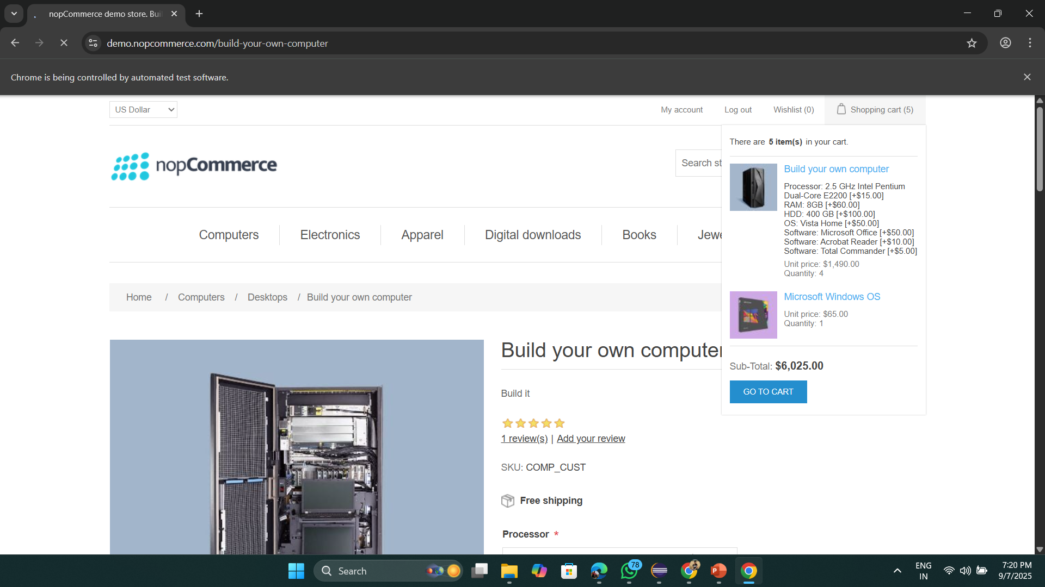
Hovering on Shopping Cart

Slide 18
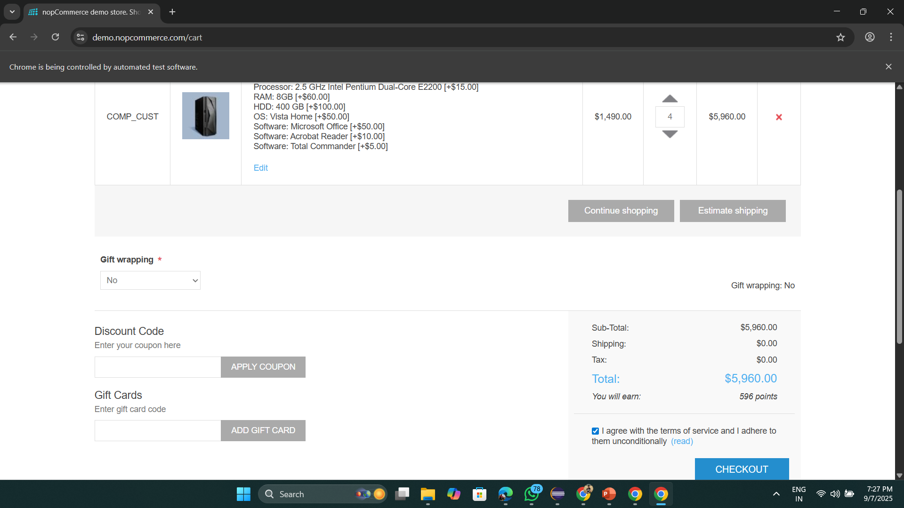




Validating Checkout Flow

Slide 19
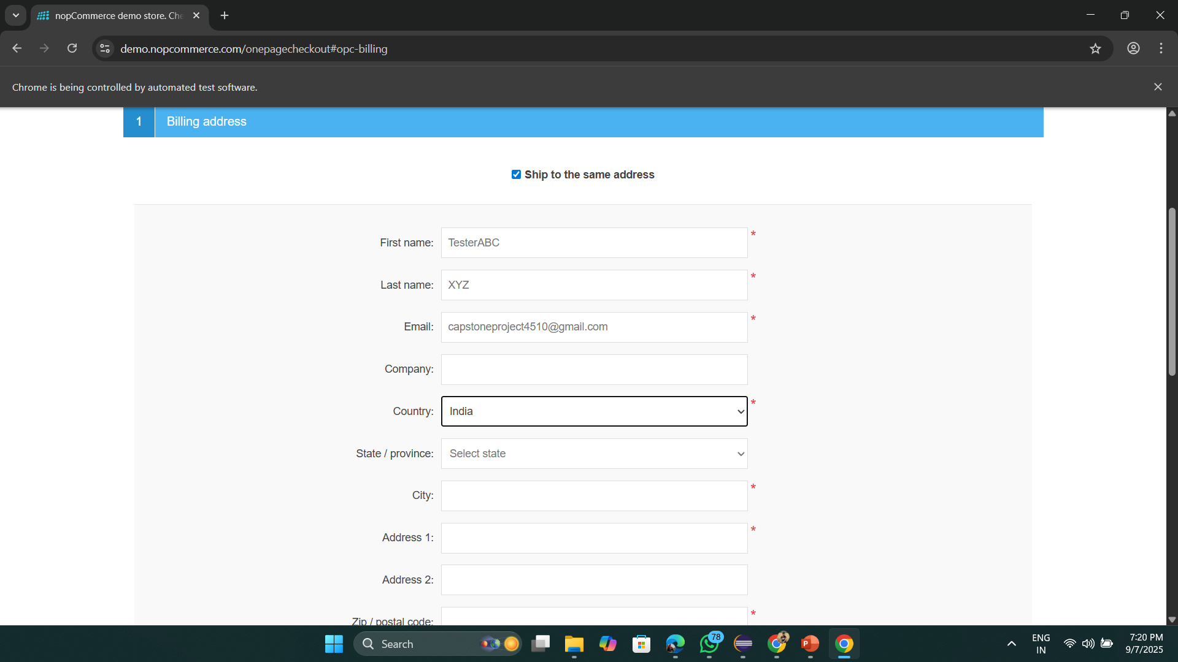
Billing Address details entering

Slide 20
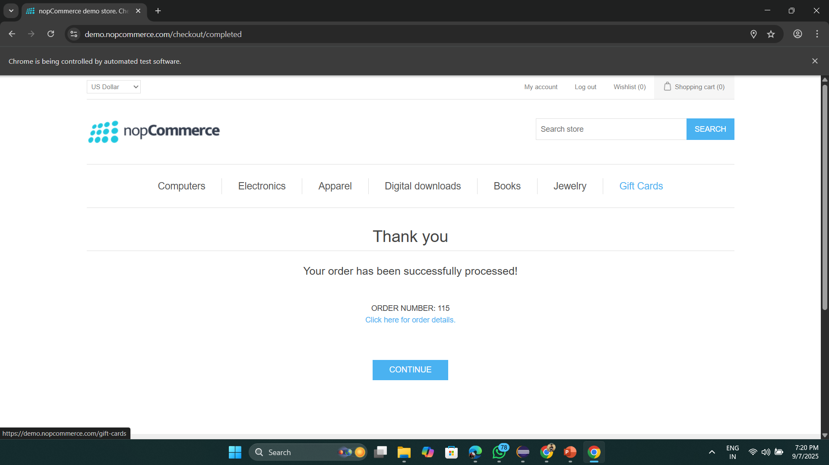





Order Placed Successfully

Slide 21




All Test Cases Passed Extent Report

Slide 22
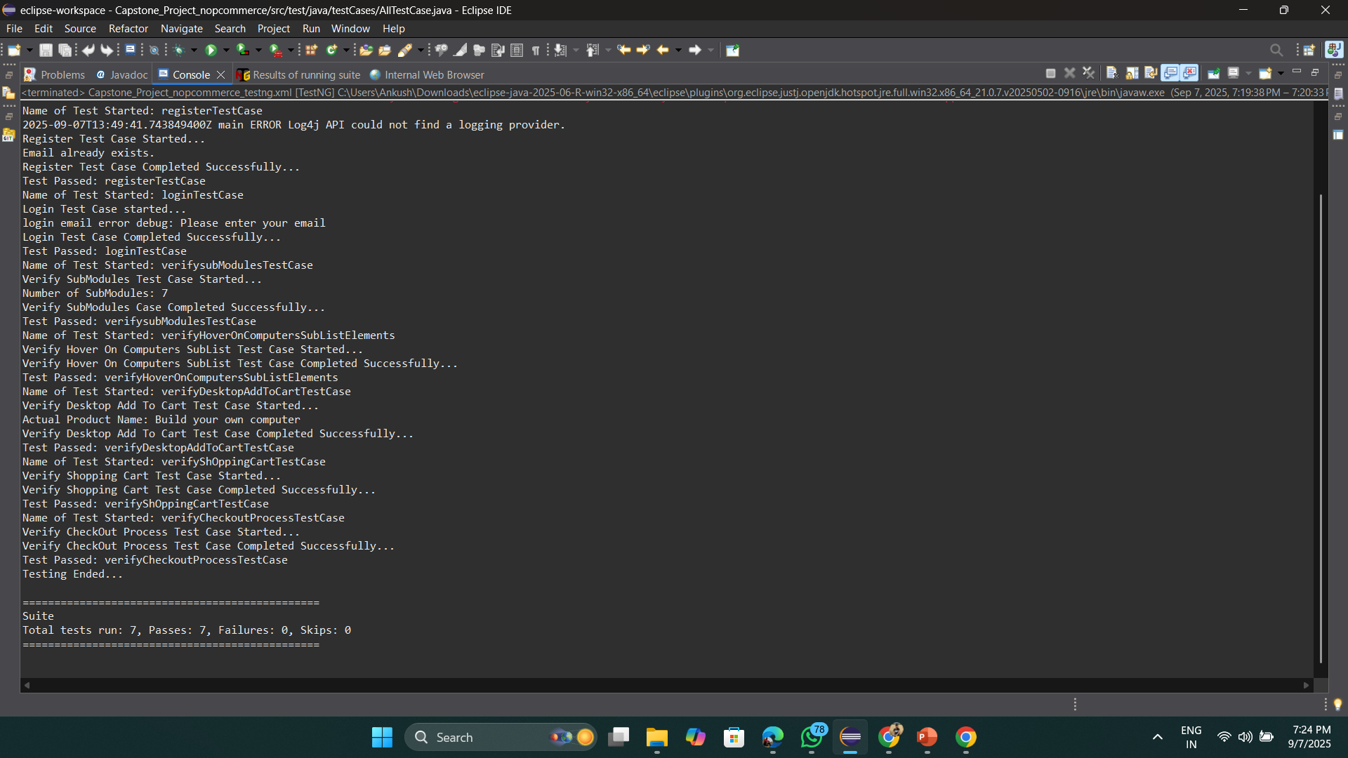




All Test Cases Passed Console Logs

Slide 23
Thank You

